Slide 1
Enhanced Security Linux
SELINUX

Slide 2
Objectives
Understand the relation between SELinux and Security
Understand how SELinux works
Know some basic useful tools to manage SELinux.
Notes:
Mencionar que solo tenemos 2.5 horas

Slide 3
Agenda
Introduction
The Big Picture
Labels
Troubleshooting
Scenarios
Notes:
Breve descripcion de cada topico.

Slide 4
INTRODUCTION

Slide 5
What is SELinux ?
Is an exciting new technology for securing our computer networks and systems.
SELinux is not:
  a replacement for password, firewall, or other security. systems.
  Antivirus software.
  An all-in-one security solution.
Notes:
No se confia en la NSA.

Slide 6
Why Should I Use SELinux?
Security of the Operating system depends on users!
Cannot avoid software fails!
SELinux enforces the principle of Least Privilege
Notes:
La seguridad no se les puede dejar en manos de los usuarios.

Slide 7
Disadvantages
Performance . . .?
Microbenchmark | Base | SELinux | Overhead
file copy 4KB | 49.5 | 48.6 | 2%
file copy 1KB | 40.4 | 38.6 | 5%
file copy 256B | 23.0 | 21.0 | 10%
pipe | 6.17 | 7.17 | 16%
pipe switching | 12.7 | 15.0 | 18%
process creation | 485 | 494 | 2%
execl | 2480 | 2610 | 5%
shell scripts (8) | 659 | 684 | 4%
Notes:
resultados del macrobenchmark son buenos.

Slide 8
Distributions Using SELinux
Fedora
Fedora derived distributions such as Red Hat Enterprise Linux
Debian
Gentoo
Ubuntu
Notes:
Pregunta para ellos.
Puedo instalar selinux en un distro que no lo tenga ?

Slide 9
DAC
DAC (Discretionary Access Control)
  chmod, chwon, chattf, facl
  System security is left to the discretion of users and daemons.
  When user account or application is compromised, security is compromised.
Notes:
Mostrar los otros mecanismos
setuid
setgid
bit pegajoso
Capabilities:
setfacl
getfacl
Attributes:
chattr
lsattr

Slide 10

The Problem With DAC
uid: joe
ruid: root
uid: joe
euid: joe
r-- --- --- root root
bash→passwd
bash
/etc/shadow
rs--x--x root root
/usr/bin/passwd
Notes:
En caso de un usuario malicioso, mostrar que un usuario que gana permisos de Root puede hacer lo que quiera

Slide 11
SELinux Modes
Disabled
The kernel uses only DAC rules for access control. SELinux does not enforce any security policy because no policy is loaded into the kernel.
Enforcing
The kernel denies access to users and programs unless permitted by SELinux security policy rules. All denial messages are logged as AVC (Access Vector Cache) denials. This is the default mode that enforces SELinux security policy.
Permissive
SELinux prints warnings instead of enforcing.
Notes:
HABILITAR Y DESHABILITAR
4 metodos para habilitar/deshabilitar SELinux
- parametros en el boot (grub) selinux=1 enforcing=0
- archivo de configuracion
- por comando
- escribiendo en /sys/fs
proteger que no lo deshabiliten
# setsebool -P secure_mode_policyload on

Slide 12
THE BIG PICTURE

Slide 13
Integrated In The Linux Kernel
Process
Look data
Error checks
DAC checks
LSM hook
Linux Security
Module
(e.g. SELinux)
OK
Notes:
-MAC esta despues de DAC.
-En cada lectura/escritura se revisan los permisos.

Slide 14
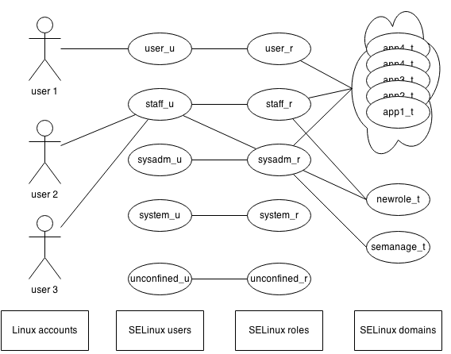
Labels
Notes:
Las configuracion son subconjuntos de los labels.
Usuarios Linux diferente de usuarios SELinux

Slide 15
Labels
Notes:
Todo tiene etiqueta !!!!!

Slide 16
SELinux Modes
Disabled
The kernel uses only DAC rules for access control. SELinux does not enforce any security policy because no policy is loaded into the kernel.
Enforcing
The kernel denies access to users and programs unless permitted by SELinux security policy rules. All denial messages are logged as AVC (Access Vector Cache) denials. This is the default mode that enforces SELinux security policy.
Permissive
SELinux prints warnings instead of enforcing.
Notes:
HABILITAR Y DESHABILITAR
4 metodos para habilitar/deshabilitar SELinux
- parametros en el boot (grub) selinux=1 enforcing=0
- archivo de configuracion
- por comando
- escribiendo en /sys/fs
proteger que no lo deshabiliten
# setsebool -P secure_mode_policyload on

Slide 17
Set SELinux Modes
To get the current mode to Enforcing, enter:
# getenforce
To set the current mode to Enforcing, enter:
# setenforce Enforcing
To set the current mode to Permissive, enter:
# setenforce Permissive
Configuration file
/etc/selinux/config
Directive: SELINUX
Configuration file
/etc/selinux/config

Slide 18
SELinux Policies
Targeted Policy
Is the default SELinux policy used in Red Hat Enterprise Linux. Processes that are targeted run in a confined domain, and processes that are not targeted run in an unconfined domain.
Multilevel Security (MLS) Policy
Minimum
Configuration file
/etc/selinux/config
Directive: SELINUXTYPE
Notes:
/usr/share/selinux/
/etc/selinux

Slide 19
Looking At The Security Context
The security context is made up of 3 or 4 components
separated by “:”.
unconfied_u
unconfied_u
unconfied_r
unconfied_t
s0-s0:.c0.c1023
SELinux user
SELinux role
SELinux type
Sensitivity level
Domain for processes and Type for objects.
Example:
Apahe daemon
system_u:system_r:httpd_t
/etc/passwd
system_u:object_r:etc_r
Notes:
unconfined_t no se quiere restringir

Slide 20
Type Enforcement System
user_t
bit_t
subject
object
euid: root
passwd_t
r--------- root root
shadow_t
passwd
/etc/shadow

Slide 21
-Z Is Your Friend
SELinux modifies many system commands by adding the -Z `option to display context of objects and subjects.
$ id -Z
Joe: user_r: user_t
Applications do not need to be aware of SELinux.
Some packages are SELinux aware.
Notes:
explicar contexto en /etc/* y /etc/passwd
explicar las el archivo con las definiciones de los contextos

Slide 22
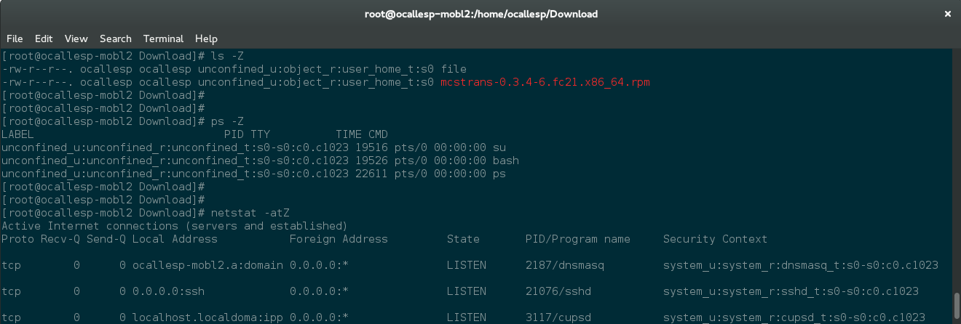
Everything Is Labeled
Notes:
Abrir terminal y mostrar
ls -Z
mostrar que usuario SELinux soy y mi contexto
id -Z
mostrar que los procesos tambien tienen etiquetas
ps -eZ
Semanage port -l

Slide 23
SELinux Roles
Role | Description
user_r | This role is meant for restricted for users. Is only allowed to have process with types specific to end-user applications.
staff_r | For non-critical operators tasks. Is generally restricted to the same applications as the restricted user, but also allowed to more privileged types.
sysadm_r | Very privileged, allowing for various system administration tasks.
system_r | For daemons and background processes, is quite privileged. User applications and other administrative types are not allowed.
unconfined_r | Protect only certain processes (mostly daemons) while keeping the rest of the system operations almost untouched by SELinux.

Slide 24
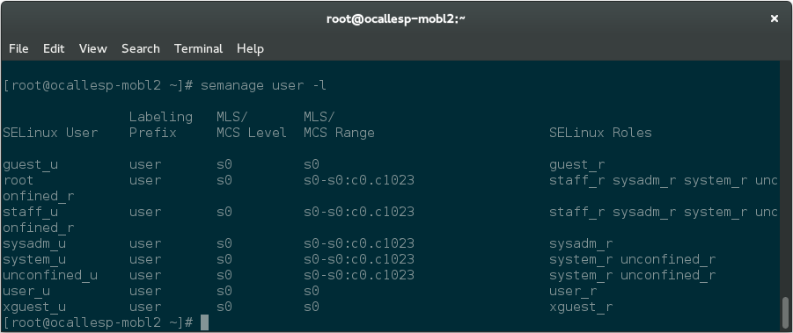
How To Get the List of Users ?
Notes:
Explicar allow, auditallow, dontaudit,neverallow

Slide 25
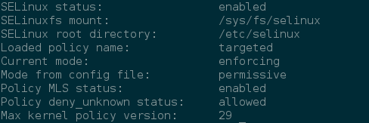
Get The Status Of SELinux
$ sestatus
Policy versions:
http://selinuxproject.org/page/NB_PolicyType
Notes:
Configurar deny_unknown en semanage.con
handle_unknown=allow,deny,reject

Slide 26
Process Transition - Graphical
allowed type
system_r
initrc_t
transition
httpd_t
entrypoint
execute
http_exec_t

Slide 27
Process Transition - Rules
type_transition initrc_t httpd_exec_t : process httd_t
Allow initrc_t httpd_t : process transition
Allow initrc_t httpd_exec_t : file { read, execute …}
Allow httpd_t httpd_exec_t : file { entrypoint …}
Notes:
Buscarlos con sesearch

Slide 28
MAC
uid: joe
ruid: root
passwd_t
uid: joe
euid: joe
user_t
r-- --- --- root root
shadow_t
passwd
bash
/etc/shadow
rs--x--x root root
passwd_exec_t
allow user_t passwd_exec_t: file{getattr execute};
allow passwd_t passwd_exec_t: file entrypoint;
allow user_t passwd_t: process transition
/usr/bin/passwd
Notes:
Mostrar la ventaja de MAC sobre DAC

Slide 29
Recommendations
Do not disable SELinux
  For security reasons
  When turning on, we need to fix wrong (or absent) labels.
When changing policy type:
  Reboot and possible relabel in you change the policy type

Slide 30
Customizing SELinux Policies
Display all boolean values together with a short description.
# semanage boolean -l
You can use the getsebool and setsebool commands to
display and set the value of a specific boolean.
# setsebool boolean on|off

Slide 31
SELinux Boolean
The SELinux policy can include conditional rules that are enabled or disabled based on the current values of a set of policy booleans. These policy booleans allow runtime modification of the security policy without having to load a new policy.
Get the list of all the booleans:
$ getsebool -a
# semanage boolean -l

Slide 32
TROUBLESHOOTING

Slide 33
Debugging
Set SELinux
Permissive
Disable don't
audit
Search AVC
messages
More AVC
Messages?
Modify policy
- Enable/Disable
Booleans
Set SELinux
Enforcing

Slide 34
Interpreting Log Messages
Get permission error messages in the audit file, /var/log/audit/audit.log.
Use the AVC and USER_AVC message types to find AVC denied alerts:
# ausearch -i -m AVC, USER_AVC -sv no
type=AVC msg=audit(05/11/2015 05:30:17.223:4424) : avc: denied { rlimitinh }
for pid=3175 comm=setroubleshootd
scontext=system_u:system_r:system_dbusd_t:s0-s0:c0.c1023
tcontext=system_u:system_r:setroubleshootd_t:s0-s0:c0.c1023
tclass=process permissive=0
Notes:
mostrar cuando se genera un AVC y cuando no
$ su -
revisar
$ ls /proc/1
revisar

Slide 35
Uncovering More Denials
Show dontaudit messages from logs
# seinfo | grep -E '(dontaudit|allow)'
Allow: 523 Neverallow: 0
Auditallow: 1 Dontaudit: 300
Type_member: 6 Role allow: 7
# semodule --disable_dontaudit --build
Hide dontaudit messages from logs
# semodule --build
Notes:
Hacer permisivo solamente un tipo
$ man semanage permissive
# semanage permissive -a algun_tipo_dominio
mostrar la lista de dominios permisivos

Slide 36

Possible Problems To Resolve
Wrong subject (source) context.
Wrong object (target) context.
Right subject and Object context but no access.
An intrusion?

Slide 37
Changing SELinux Context
Set context of a file
# chcon -t type pathto/file
# fixfiles relabel ---- FALTA COMPLETAR
Set changes permanently
# semanage fcontext -a -t type “pathto/file”
# restorecon -R -v pathtofile

Slide 38
Copying And Moving Files
mv vs cp
mv command maintain the security context of the file when it is moved to a different directory.
The cp command acts a little differently.
If a file exists that your are copying over, the new file will maintain the file context of the previous file.
If the files does not exist, it will either get the security context of the directory, or, if a file transition rule exists, it will transition the context to follow the rule.

Slide 39
SCENARIOS

Slide 40
Labeling The Filesystem
If the system has been running in disabled mode, newly created file system objects will not be labeled with the security context.
To set the file systems to be relabeled on reboot, do:
and reboot.
# touch /.autorelabel

Slide 41
Building A SELinux Policy
Generate module source
# ausearch -i -m AVC -sv no -ts recent -se anytype
| audit2allow -m module_name > module_name.te
Compile the policy source module
# checkmodule -M -m -o module_name.mod module_name.te
Create a SELinux policy module package and install it.
# semodule_package -o module_name.pp -m module_name.mod
# semodule --install module_name.pp

Slide 42
Cannot See My Webpage
Turn SELinux on and set to Enforcing
# vi -R /etc/http/conf/httpd.conf
# cd /web
# ls -Z
# systemctl start httpd
# elinks http://localhost
# semanage fcontext -a -t httpd_sys_content_t “/web(.*)?”
# restoracon -R -v /web

Slide 43
Building A SELinux Policy
Generate module source
# ausearch -i -m AVC -sv no -ts recent -se anytype
| audit2allow -m module_name > module_name.te
Compile the policy source module
# checkmodule -M -m -o module_name.mod module_name.te
Create a SELinux policy module package and install it.
# semodule_package -o module_name.pp -m module_name.mod
# semodule --install module_name.pp

Slide 44
Copy Files
$ echo “file in Download” /home/bobby/Download/file.txt
$ ls -Z /home/bobby/Download/file.txt
$ echo “file in tmp” /tmp/file.txt
$ ls -Z /tmp/file.txt
$ cp /tmp/file.txt /home/bobby/Download/file.txt
$ rm /home/bobby/Download/file.txt
$ cp /tmp/file.txt /home/bobby/Download/file.txt
$ rm /home/bobby/Download/file.txt
$ mv /tmp/file.txt /home/bobby/Download/file.txt
Notes:
Hacer incapie en usar copy en lugar de move

Slide 45
I Want To Make A Backup
Archive and preserve SELinux contexts, extended attributes, and ACLs.
To extract
$ tar –selinux –acls –xattrs \
-cvf backup.tar /pathtofiles/
$ tar –selinux –acls –xattrs \
-xvf backup.tar

Slide 46
Port Mapping
List all port defitions
# semanage port -l
Allow Apache to listen on tcp port 81
# semanage port -a -t http_port_t -p tcp 81
Allow sshd to listen on tcp port 8991
# semanage port -a -t ssh_port_t -p tcp 8991

